Slide 1
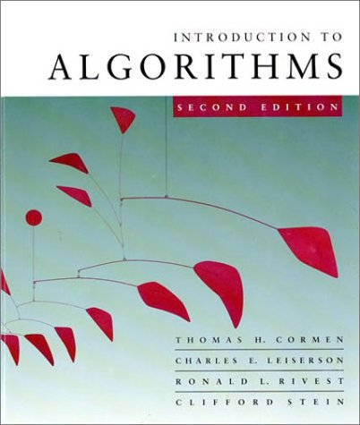
Introduction to Algorithms
6.046J/18.401J/SMA5503
Lecture 14
Prof. Erik Demaine

Slide 2
Fixed-universe successor problem
Goal: Maintain a dynamic subset S of size n
of the universe U = {0, 1, …, u – 1} of size u
subject to these operations:
  INSERT(x ∈ U \ S): Add x to S.
  DELETE(x ∈ S): Remove x from S.
  SUCCESSOR(x ∈ U): Find the next element in S
  larger than any element x of the universe U.
  PREDECESSOR(x ∈ U): Find the previous
  element in S smaller than x.

Slide 3
Solutions to fixed-universe successor problem
Goal: Maintain a dynamic subset S of size n
of the universe U = {0, 1, …, u – 1} of size u
subject to INSERT, DELETE, SUCCESSOR, PREDECESSOR.
Balanced search trees can implement operations in
O(lg n) time, without fixed-universe assumption.
In 1975, Peter van Emde Boas solved this problem
in O(lg lg u) time per operation.
  If u is only polynomial in n, that is, u = O(n^{c}),
  then O(lg lg n) time per operation--
  exponential speedup!

Slide 4
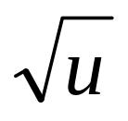
O(lg lg u)?!
Where could a bound of O(lg lg u) arise?
  Binary search over O(lg u) things
  T(u) = T( ) + O(1)
  T’(lg u) = T’((lg u)/2) + O(1)
  = O(lg lg u)

Slide 5
(1) Starting point: Bit vector
Bit vector v stores, for each x ∈ U,
1 if x ∈ S
v_{x} =
0 if x ∉ S
Example: u = 16; n = 4; S = {1, 9, 10, 15}.
0
1
0
0
0
0
0
0
0
1
1
0
0
0
0
1
0
1
2
3
4
5
6
7
8
9
10
11
12
13
14
15
Insert/Delete run in O(1) time.
Successor/Predecessor run in O(u) worst-case time.

Slide 6
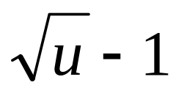
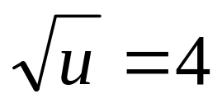
(2) Split universe into widgets
Carve universe of size u into widgets
W₀, W₁, …, W
each of size
.
Example: u = 16,
.
W₀
W₁
W₂
W₃
0
1
0
0
0
0
0
0
0
1
1
0
0
0
0
1
0
1
2
3
4
5
6
7
8
9
10
11
12
13
14
15

Slide 7
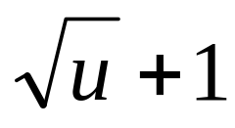
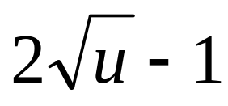
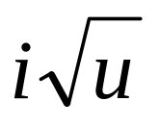
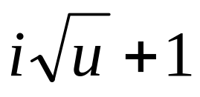
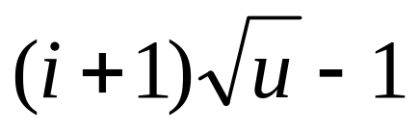
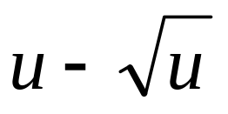
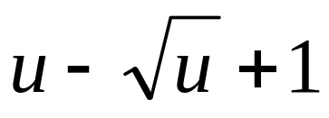
(2) Split universe into widgets
Carve universe of size u into widgets
W₀, W₁, …, W
each of size
.
W₀ represents 0, 1, …,
∈ U;
W₁ represents
,
, …,
∈ U;
:
W_{i} represents
,
, …,
∈ U;
:
W represents
,
, …,
u – 1 ∈ U.

Slide 8
(2) Split universe into widgets
x = 9
Define high(x) ≥ 0 and low(x) ≥ 0
so that x = high(x)
That is, if we write x ∈ U in binary,
high(x) is the high-order half of the bits,
and low(x) is the low-order half of the bits.
For x ∈ U, high(x) is index of widget containing x
and low(x) is the index of x within that widget.
1
0
0
1
+ low(x).
high(x)
= 2
low(x)
= 1
W₀
W₁
W₂
W₃
0
1
0
0
0
0
0
0
0
1
1
0
0
0
0
1
0
1
2
3
4
5
6
7
8
9
10
11
12
13
14
15

Slide 9
(2) Split universe into widgets
INSERT(x)
  insert x into widget W_{high(x)} at position low(x).
  mark W_{high(x)} as nonempty.
Running time T(n) = O(1).

Slide 10
(2) Split universe into widgets
SUCCESSOR(x)
  look for successor of x within widget W_{high(x)}
  starting after position low(x).
  if successor found
  then return it
  else find smallest i > high(x)
  for which W_{i} is nonempty.
    return smallest element in W_{i}
O( )
O( )
O( )
Running time T(u) = O( ).

Slide 11
Revelation
SUCCESSOR(x)
  look for successor of x within widget W_{high(x)}
  starting after position low(x).
  if successor found
  then return it
  else find smallest i > high(x)
  for which W_{i} is nonempty.
    return smallest element in W_{i}
recursive
successor
recursive
successor
recursive
successor

Slide 12
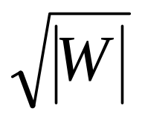
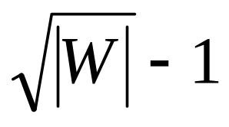
(3) Recursion
Represent universe by widget of size u.
Recursively split each widget W of size |W|
into
sub[W][
subwidgets sub[W][0], sub[W][1], …,
] each of size
.
Store a summary widget summary[W] of size
representing which subwidgets are nonempty.
W
summary[W]
sub[W][0]
sub[W][1]
…
sub[W][ ]

Slide 13
(3) Recursion
Define high(x) ≥ 0 and low(x) ≥ 0
so that x = high(x)
+ low(x).
INSERT(x, W)
  if sub[W][high(x)] is empty
  then INSERT(high(x), summary[W])
  INSERT(low(x), sub[W][high(x)])
Running time T(u) = 2 T( ) + O(1)
T’(lg u) = 2 T’((lg u) / 2) + O(1)
= O(lg u) .

Slide 14
(3) Recursion
SUCCESSOR(x, W)
  j ← SUCCESSOR(low(x), sub[W][high(x)])
  if j < ∞
  then return high(x)
  else i ← SUCCESSOR(high(x), summary[W])
    j ← SUCCESSOR(– ∞, sub[W][i])
    return i
T( )
+ j
T( )
T( )
+ j
Running time T(u) = 3 T( ) + O(1)
T’(lg u) = 3 T’((lg u) / 2) + O(1)
= O((lg u) ^{lg 3}) .

Slide 15
Improvements
Need to reduce INSERT and SUCCESSOR
down to 1 recursive call each.
1 call: T(u) = 1 T( ) + O(1)
= O(lg lg n)
2 calls: T(u) = 2 T( ) + O(1)
= O(lg n)
3 calls: T(u) = 3 T( ) + O(1)
= O((lg u) ^{lg 3})
We’re closer to this goal than it may seem!

Slide 16
Recursive calls in successor
If x has a successor within sub[W][high(x)],
then there is only 1 recursive call to SUCCESSOR.
Otherwise, there are 3 recursive calls:
  SUCCESSOR(low(x), sub[W][high(x)])
  discovers that sub[W][high(x)] hasn’t successor.
  SUCCESSOR(high(x), summary[W])
  finds next nonempty subwidget sub[W][i].
  SUCCESSOR(– ∞, sub[W][i])
  finds smallest element in subwidget sub[W][i].

Slide 17
Reducing recursive calls in successor
If x has no successor within sub[W][high(x)],
there are 3 recursive calls:
  SUCCESSOR(low(x), sub[W][high(x)])
  discovers that sub[W][high(x)] hasn’t successor.
    Could be determined using the maximum
    value in the subwidget sub[W][high(x)].
  SUCCESSOR(high(x), summary[W])
  finds next nonempty subwidget sub[W][i].
  SUCCESSOR(– ∞, sub[W][i])
  finds minimum element in subwidget sub[W][i].

Slide 18
(4) Improved successor
INSERT(x, W)
  if sub[W][high(x)] is empty
  then INSERT(high(x), summary[W])
  INSERT(low(x), sub[W][high(x)])
  if x < min[W] then min[W] ← x
  if x > max[W] then max[W] ← x
new (augmentation)
Running time T(u) = 2 T( ) + O(1)
T’(lg u) = 2 T’((lg u) / 2) + O(1)
= O(lg u) .

Slide 19
(4) Improved successor
SUCCESSOR(x, W)
  if low(x) < max[sub[W][high(x)]]
  then j ← SUCCESSOR(low(x), sub[W][high(x)])
      return high(x)
  else i ← SUCCESSOR(high(x), summary[W])
    j ← min[sub[W][i]]
    return i
T( )
+ j
T( )
+ j
Running time T(u) = 1 T( ) + O(1)
= O(lg lg u) .

Slide 20
Recursive calls in insert
If sub[W][high(x)] is already in summary[W],
then there is only 1 recursive call to INSERT.
Otherwise, there are 2 recursive calls:
  INSERT(high(x), summary[W])
  INSERT(low(x), sub[W][high(x)])
Idea: We know that sub[W][high(x)]) is empty.
Avoid second recursive call by specially
storing a widget containing just 1 element.
Specifically, do not store min recursively.

Slide 21
(5) Improved insert
INSERT(x, W)
  if x < min[W] then exchange x ↔ min[W]
  if sub[W][high(x)] is nonempty, that is,
  min[sub[W][high(x)] ≠ NIL
  then INSERT(low(x), sub[W][high(x)])
  else min[sub[W][high(x)]] ← low(x)
  INSERT(high(x), summary[W])
  if x > max[W] then max[W] ← x
Running time T(u) = 1 T( ) + O(1)
= O(lg lg u) .

Slide 22
(5) Improved insert
SUCCESSOR(x, W)
  if x < min[W] then return min[W]
  if low(x) < max[sub[W][high(x)]]
  then j ← SUCCESSOR(low(x), sub[W][high(x)])
      return high(x)
  else i ← SUCCESSOR(high(x), summary[W])
    j ← min[sub[W][i]]
    return i
new
T( )
+ j
T( )
+ j
Running time T(u) = 1 T( ) + O(1)
= O(lg lg u) .

Slide 23
Deletion
DELETE(x, W)
  if min[W] = NIL or x < min[W] then return
  if x = min[W]
  then i ← min[summary[W]]
      x ← i
      min[W] ← x
  DELETE(low(x), sub[W][high(x)])
  if sub[W][high(x)] is now empty, that is,
  min[sub[W][high(x)] = NIL
  then DELETE(high(x), summary[W])
      (in this case, the first recursive call was cheap)
+ min[sub[W][i]]

